Slide 1
CNS102b Super-normal stimuli
Stimuli with artificially exaggerated evolutionarily-relevant features are preferred
More, not better

Slide 2
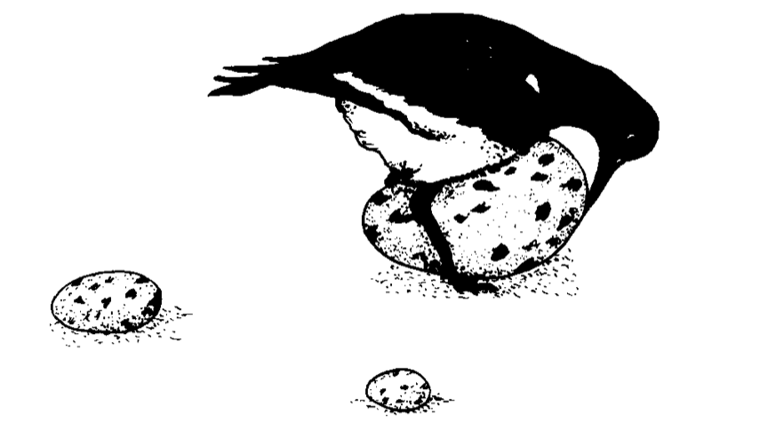

Slide 3
outline
biology of SNS
humans: faces
peak-shift and signal detection
toy model: movie candy
humans: food, sex, danger
caveats

Slide 4
1. Biology of SNS gulls (Lorenz c 1950s)

Slide 5

Fixed action patterns (Tinbergen, Lorenz) (factory-installed ‘wetware’)

Slide 6

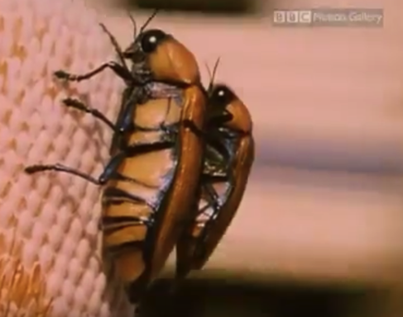
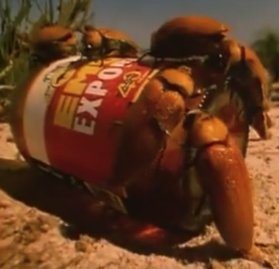
Australian jewel beetles ( are large, orange, dimpled backs)
https://www.youtube.com/watch?v=t1pOZbytOhE

Slide 7
Peak shift in bumblebee choice of artificial flowers with liquid rewards (Lynn EncyclAnimBehav 2010)
peak shift
S+ h20 + 50% sucrose
S- 3%NaCl salt water
Notes:
Lynn 2010 Encyclo Animal Behavior

Slide 8
Notes:
Lynn 2010 Encyclo Animal Behavior

Slide 9
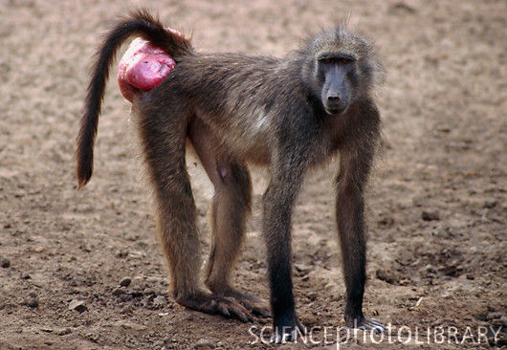
Other species
Butterflies (flutter rate and mating)
Peacock (“eye” on tail)
Birds (egg size, parent beak coloring)
Chacma baboons (swollen perineum)
"...no case interested and perplexed me so much as the brightly-coloured hinder ends and adjoining parts of certain monkeys.
Notes:
Darwin (1876"...no case interested and perplexed me so much as the brightly-coloured hinder ends and adjoining parts of certain monkeys.
): ..no case interested and perplexed me so much as the brightly-coloured hinder ends and adjoining parts of certain monkeys.

Slide 10
Human face caricature effects
Who is it on the next slide?

Slide 11
Notes:
“Caricature effect” e.g. Lee et al Psych Sci 2000

Slide 12
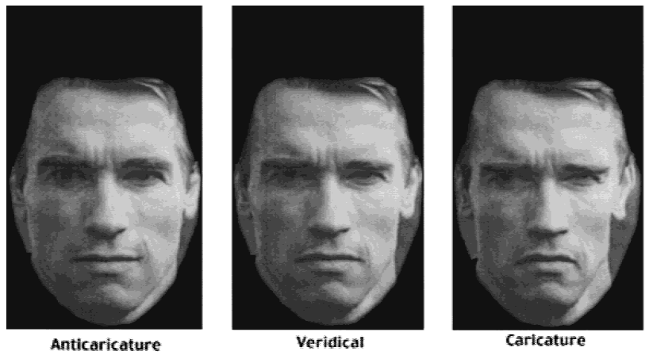
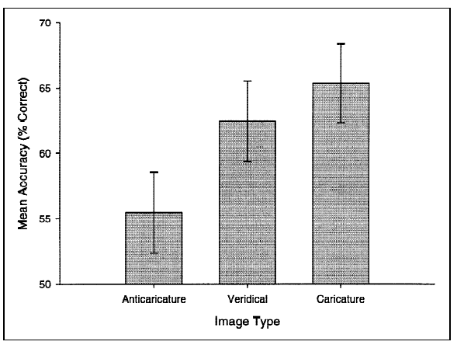
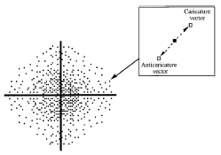
33, 100 msec exposure supernormally-distinctive faces are recognized better
Lee+ PSCI 2000
Notes:
“Caricature effect” e.g. Lee et al Psych Sci 2000
Face space theory

Slide 13
Are there human SNS?
No: Human perception is much better
Yes: Technology exploits evolutionary vulnerability if profitable
Can markets create “exploitative” SNS?
Examples: Food, mate choice
Modelling: SNS snack food with monopoly power
Welfare?

Slide 14
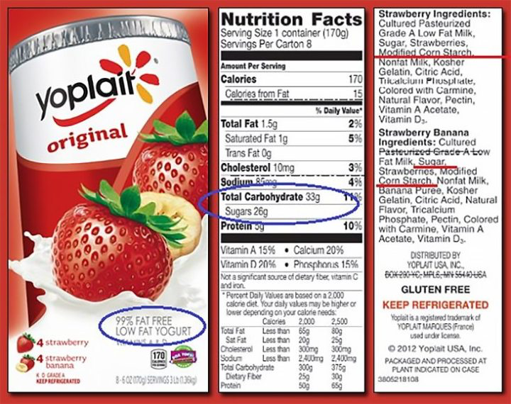
Food

Slide 15
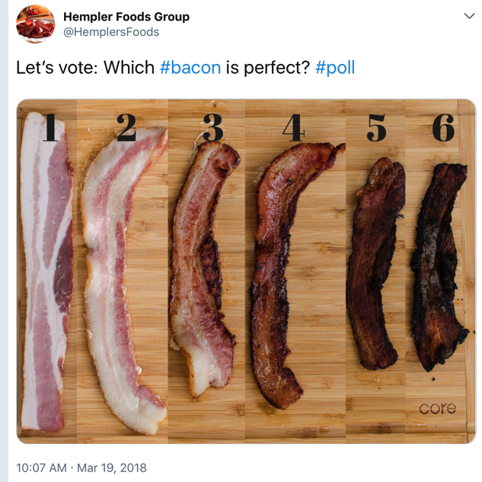
uncooked S- S+

Slide 16
Food
Taste evolved as a proxy for hidden nutrition
Sugar: Pre-agrarian, sugar a good proxy for nutrition (and rare)
Ripe fruit, raw honey, mothers’ milk
Fat: FINISH
Modern food engineering:
Create taste >> nutrition (if expensive)

Slide 17
Food tastes affected by history
China:
Disastrous “great leap forward” 1958 (55M starved)
No-meat became S-
Large amount of meat became SNS for Chinese

Slide 18
Food tastes affected by media
TV advertising (Tasar 1989)
68% high-sugar
35% high-fat,
17% high-salt
11% are low in sugar, fat and salt.
Foods requested by children follow a similar pattern
[Q: how does advertising fit into SNS, peak-shift?]

Slide 19
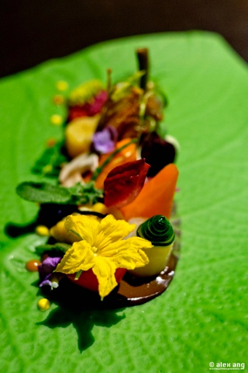
Jason Tan,
Singapore chef

Slide 20
ugly vegetables
Physical cues to ripeness
→ preference for “attractive” food

Slide 21
Mate choice
Evolutionarily important
Humans:
Cues to fertility, co-parenting resources
Perceptual uncertainty→ taste for SNS

Slide 22
Sexual characteristics
Primary (born with)
Women: ovaries, vagina, estrogen
Men: prostate, penis, testosterone
Secondary (puberty+)
Women: breasts, hourglass , more body fat
Men: body hair, “triangle” body, height , less body fat

Slide 23
supernormalized secondary characteristics
Women: larger breasts, curves, shorter, more body fat
Men: more ‘triangular’, taller, less body fat
Asymmetric child-rearing:
Exaggerated male traits associated with monogamy, resources are preferred
Wealth, stay-at-home

Slide 24
Mate choice: Men choosing fertile women
High heels and walking
Cosmetics
“natural” makeup >> no makeup
Mannequin bodies
Age:
Face cream, anti-wrinkle
Hair extensions (youth/fertility)
S-normalized secondary sexual characteristics
Hourglass figure, augmented breasts

Slide 25
Mate choice: Men choosing young, fertile women
Men are sensitive to physical cues of “residual reproductive value” (=future fertility)
“nubility hypothesis”
Enlarged (fat deposits), firm breasts are supernormalized cues of future fertility
→ breast augmentation + “mommy makeover”

Slide 26
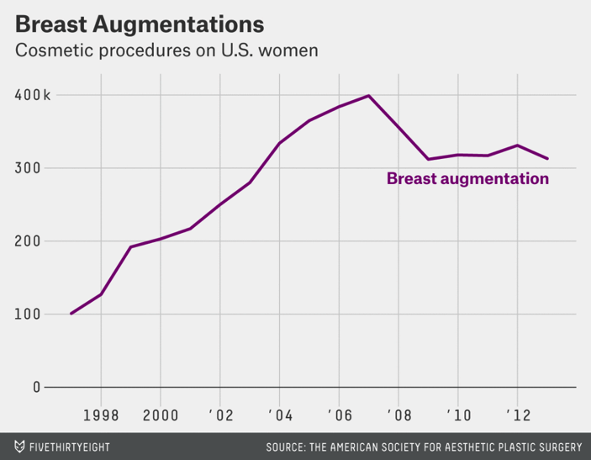
http://fivethirtyeight.com/datalab/dear-mona-what-percentage-of-women-have-breast-implants/
4% of living females in US
Notes:
4% of living females in US
Note: 23k removal operations in 2013

Slide 27
Hyperbolic language

Slide 28
6cm high heels motion-capture (Morris, EHB 2012)

Slide 29
Cosmetics “extended phenotype”
Etcoff PLOS 2011

Slide 31
http://fivethirtyeight.com/datalab/dear-mona-what-percentage-of-women-have-breast-implants/
Notes:
4% of living females in US
Note: 23k removal operations in 2013

Slide 32
Visual advertising
Claim: Advertisements are *all* SNS
Manufactured to produce maximal P(choice)
Perceptual exaggeration is common
Loosely restrained by regulation
Examples: Cosmetics, food

Slide 33
Interlude
When more is better

Slide 34
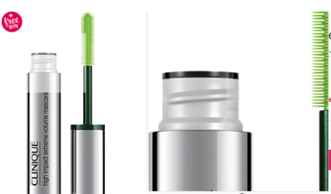
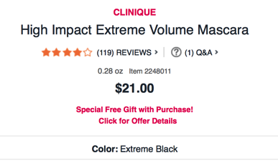
Mascara designed with exaggerated “click” when it closes (→ doesn’t dry out)
Details-
With every stroke, the over-the-top brush wraps lashes in instant, jaw-dropping drama. This larger-than-life formula is also safe for sensitive eyes and contact lens wearers. Ophthalmologist tested, too. Find your perfect Clinique mascara - Click Here!
https://www.wsj.com/articles/SB10001424052970203406404578074671598804116

Slide 35
End of interlude

Slide 36
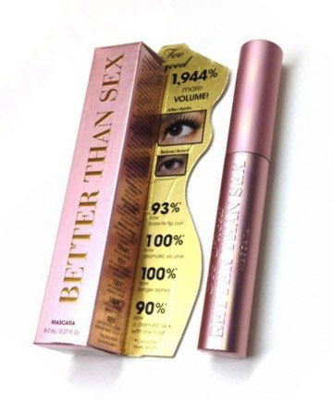

Slide 37
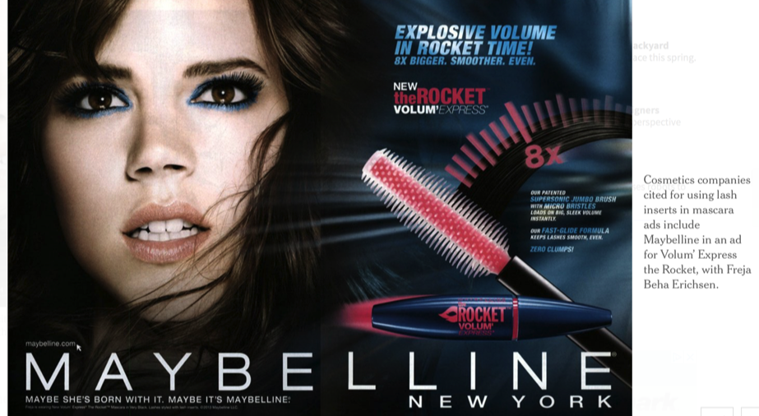
https://www.nytimes.com/2013/11/14/fashion/Mascara-Ads-Draw-Criticisms.html

Slide 38
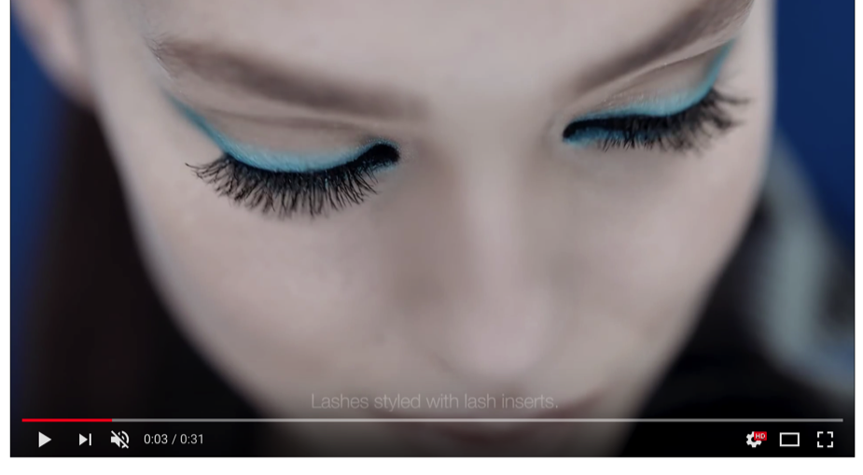
Volum'Express® The Rocket TV Commercial from Maybelline New York
https://www.youtube.com/watch?v=51Hi8YJi2mk

Slide 39
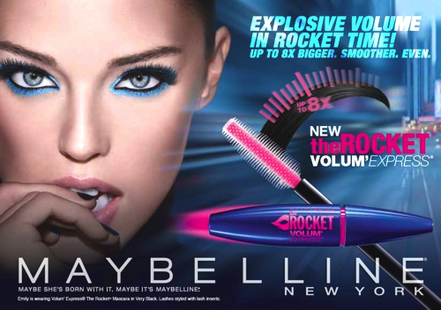

Slide 40
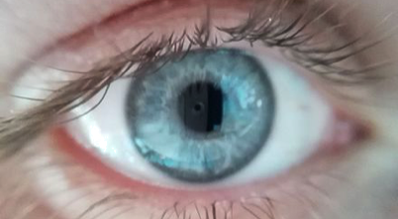
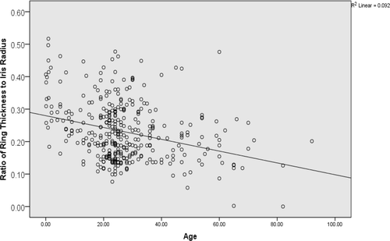
Attention to eyes
limbal ring
(around the iris)
limbal ring thins with age, some diseases
Peshek+ EvPsych 2011
Notes:
R2=.09

Slide 41
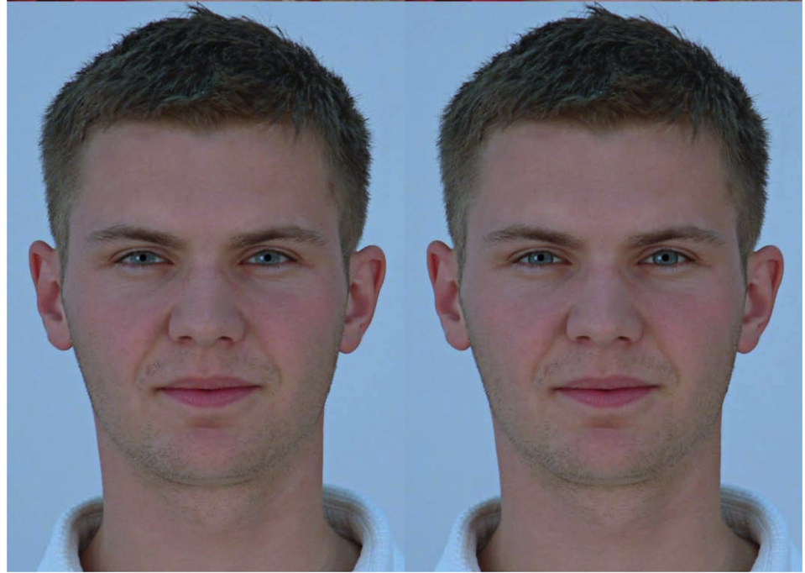
Notes:
Enhanced limbal ring on right

Slide 42
Preference for thicker limbal ring (even in inverted faces!)
Notes:
Positie rating is pref for thicker limbal

Slide 43
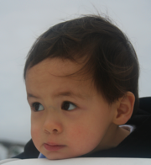
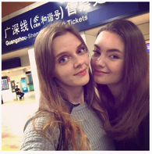
Eye features as cues to age, health
Men have less facial contrast
→ more contrast looks more female
Blackened areas around eye
→ sclera looks whiter → younger, healthier
Longer eyelashes→ noticeable eyeblink*
Human eyes do not grow
→ Larger eyes (relative to face) indicate youth
Notes:
Masha Tyelna model (L)

Slide 44
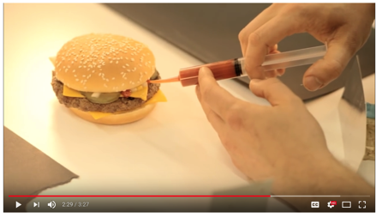
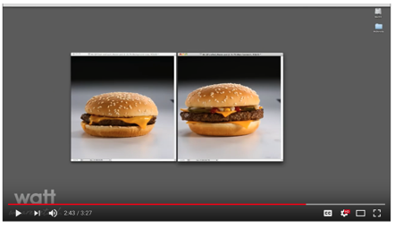
food
“Go Behind the Scenes at a McDonald's Photo Shoot | McDonald's”
“The less amount of retouching that we do to something, the less perfect it looks, but actually it looks more appetizing and more convincing” (2:45)
https://www.youtube.com/watch?v=oSd0keSj2W8

Slide 45


Slide 46
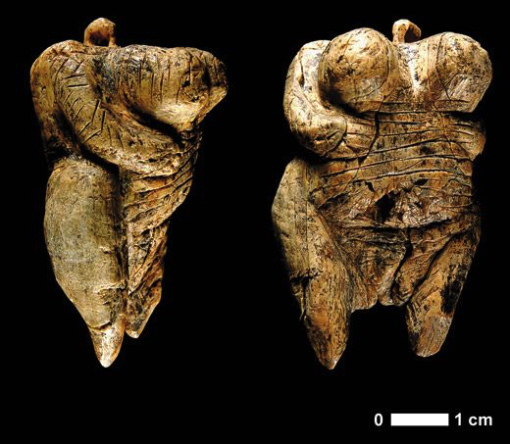
Venus of Hohle Fels (c 40,000 AD)
“Head and legs don’t matter. This is about sex, reproduction”– discoverer Nicholas Conard

Slide 47
art an SNS?
"If herring gulls had an art gallery," Ramachandran notes, "they would hang a long stick with three red strips on the wall; they would worship it, pay millions of dollars for it, call it a Picasso, but not understand why⎯why they are mesmerized by this thing even though it doesn't resemble anything. That's all any art lover is doing when buying contemporary art: behaving exactly like those gull chicks.”
RAMACHANDRAN, V. S., & HIRSTEIN, W. (1999). The science of art: A neurological theory of aesthetic experience. Journal of Consciousness Studies, 6,15-51 .
Notes:
https://www.wired.com/2009/07/neuroaesthetics/

Slide 48
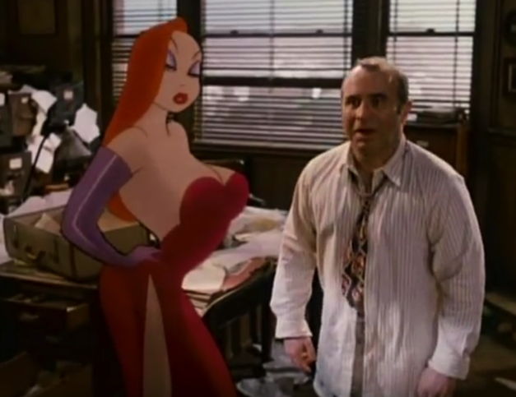
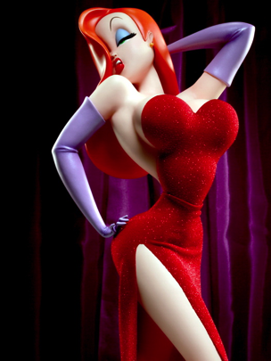
“Who framed Jessica Rabbit?”

Slide 49
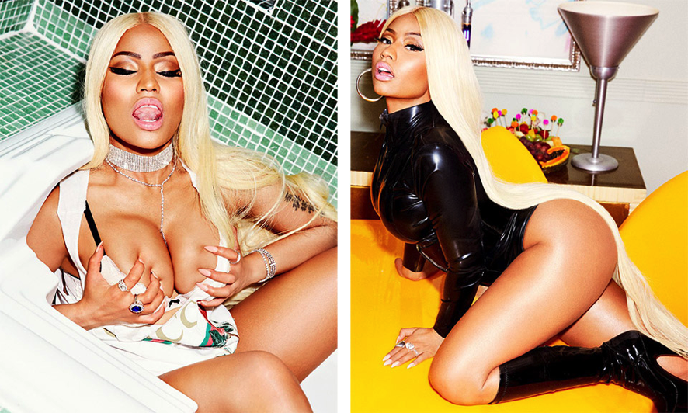
Nicki Minaj

Slide 50
Police shootings?
More perceptual uncertainty + bias –> err on the side of caution (“overpolice”)
Patrick Dorismond had no drugs
Amadou Diallo had a wallet
Michael Brown was unarmed
Philando Castile had a permit
Tamir Rice had a toy
John Crawford III had a toy in the toy aisle of a store
Alton Sterling was pinned
Freddie Gray was just riding his bike
Miriam Carey's baby was in the car

Slide 51
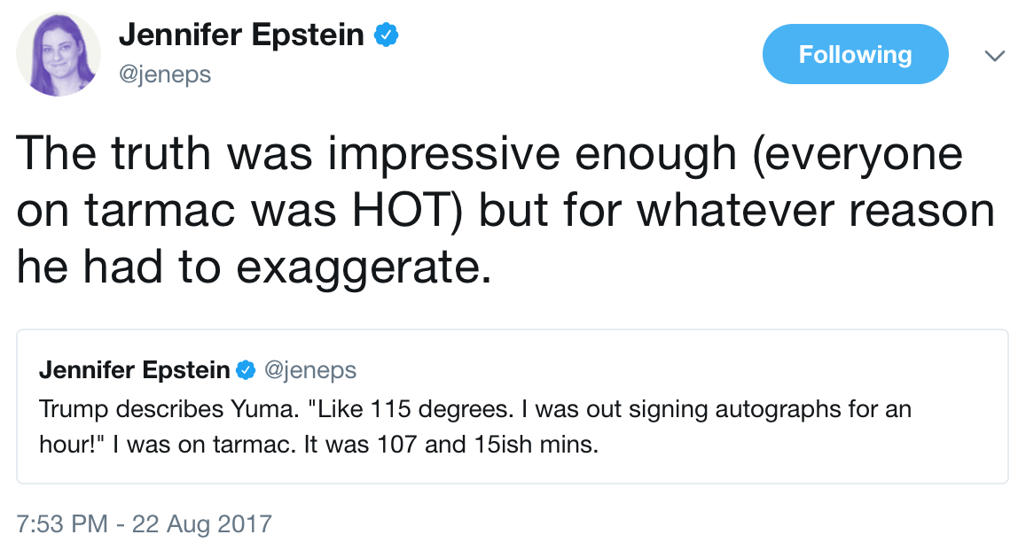
exaggerating language

Slide 52
hyperbole in business etc.
Trump “six star” seafood
“Six sigma” performance
110% (Spinal Tap up to 11)
“beyond perfect”

Slide 53
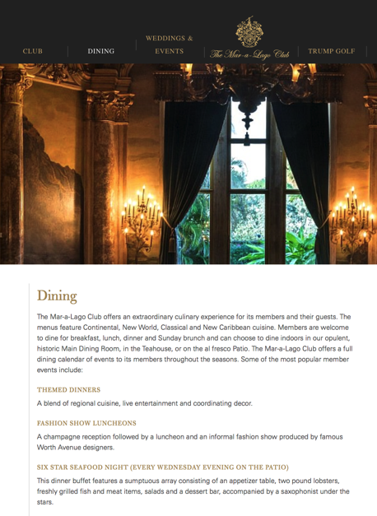

Slide 54
Research agenda
Where is SNS expected for humans?
High perceptual or value uncertainty
Children
Dolls, trucks, fictional characters, superheroes…
Teenage hygiene (e.g. Axe body spray)?
Aging populations
High reward gradient (when S+ >> S-)
Empirical markers of SNS
High “return rate”/dissatisfaction after value uncertainty is resolved
Who gets divorced?
Food waste
IO effects on SN-izeable features

Slide 55
Model example: Supersizing consumer products (movie theater candy)
Monopoly
size 3.6 price $2.88
Standard size 2 price $1
Package size

Slide 56
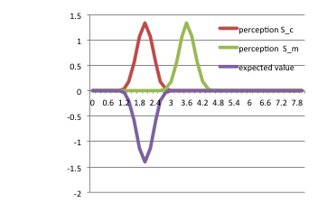
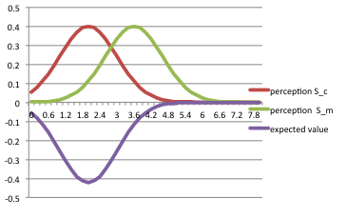
Imperfect perception of size
std dev = 1.0
std dev = .3

Slide 57
Cut price (p=$2.70), supersize (4.2)
supernormal size 4.2

Slide 58
Monopolist must underprice, supersize. Increases consumer surplus!
Monopoly
size 3.6 price $2.88
Standard size 2 price $1
Package size
Supernormal size 4.2
Price $2.70

Slide 59
Children and perceptual imperfection
Dolls
TV stars
superheroes

Slide 60
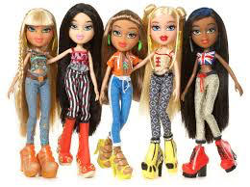
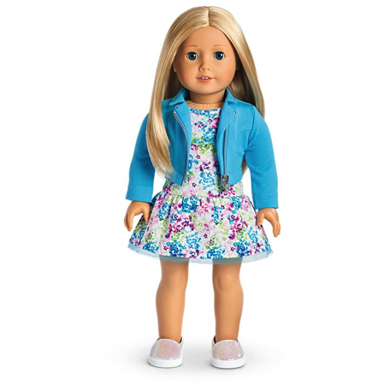
Bratz American Girl

Slide 61
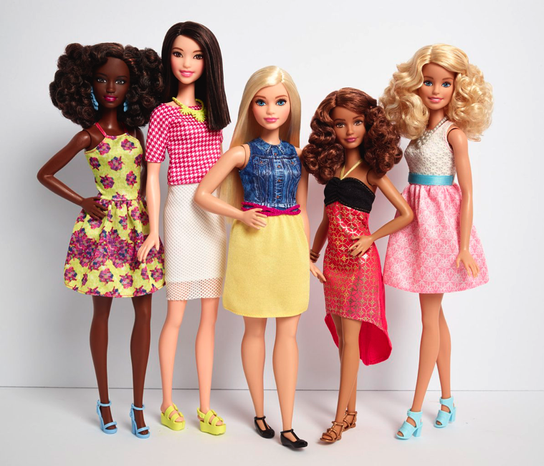
Barbie updates c 2017

Slide 62
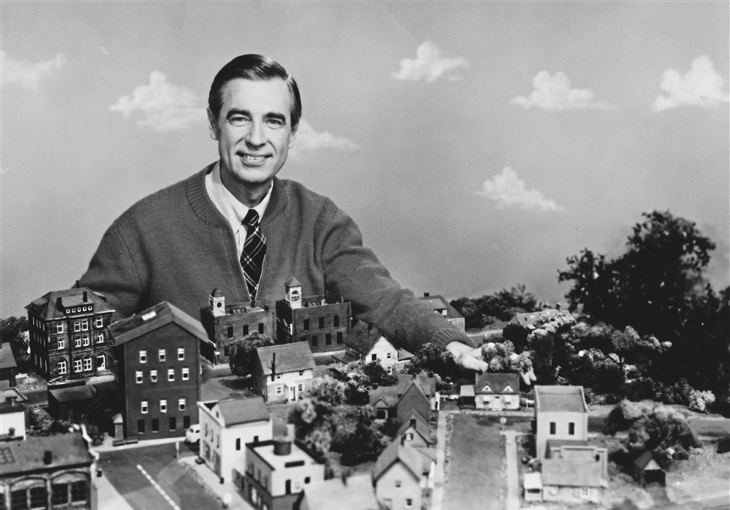
Mister Rogers: supernormally nice

Slide 63
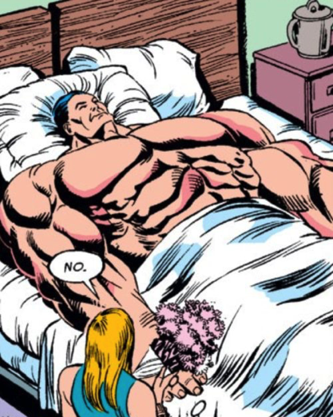
Superheroes = supernormalized humans?
Captain America

Slide 64
status and cultural artifacts
Claim:
status = cultural success
will compete for super-normalizable version
Empirics:
More status uncertainty—> more SNS status displays
Houses, cars, boats, planes, harems,
Instagram!
NFL careers (short) vs MLB?

Slide 65
water
“Water. It's necessary to sustain life, but to many Casual Dining restaurant chains it contributes to a dull dining experience for the customer. Many customers choose tap water not because they enjoy it, but because it is what they always have drunk in the past”

Slide 66
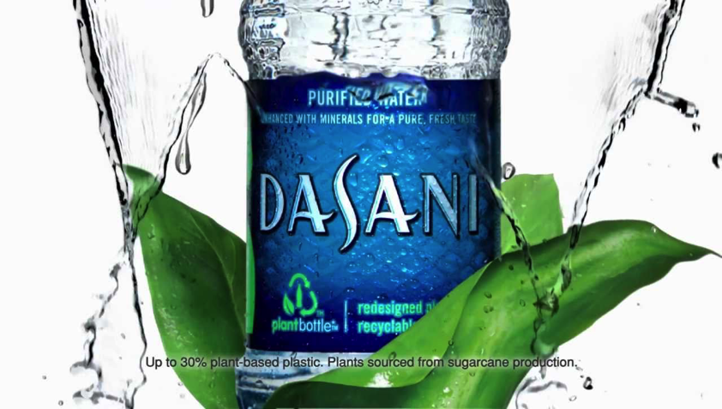
Difficult to “taste” or see 100% purity
How to test?

Slide 67
Supernormal vegetables

Slide 68
Wanting vs liking
Enhances wanting… how about liking?

Slide 69
Empirical strategy
Define SN-prone features, plain features
Will get marketplace exaggeration of SN-prone features
If adaptive coding...will get an arms race... Does it end? (is there limit to SNS? Clues from biology?) reverse uncanny valley

Slide 70
Price fx
What if SNS is more expensive?
What happens as price comes down?
Adaptive coding and substitution– generates negative externality on normal goods
e.g. regular breasts, face, regular fruit)
Argument for a tax?

Slide 71
http://fivethirtyeight.com/datalab/dear-mona-what-percentage-of-women-have-breast-implants/
Notes:
4% of living females
Note: 23k removal operations in 2013

Slide 72
Large foods sizes
Pizza cheese in crust
Botox, hair extensions etc.
“best version of herself” magazine editing
Tv – edited audio visual
Phone/social media exaggerated scope of friends and speed of social contact
Houses? Super large, oversecure (oversecurity should correlate w/ “airy” and vulnerable from outside, glass etc)
Unnaturally “pretty” food (symetric, shiny, etc)
Food looks beautiful in photos (fresh, juicy, glowing…)
“ugly fruit”/produce
High heels (paper in /folder)

